Slide 1
SceneTrilogy: On Human Scene-Sketch and its Complementarity with Photo and Text
Parsa Sharifi

Slide 2
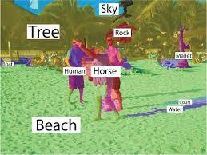
Scene understanding in computer vision

Slide 3
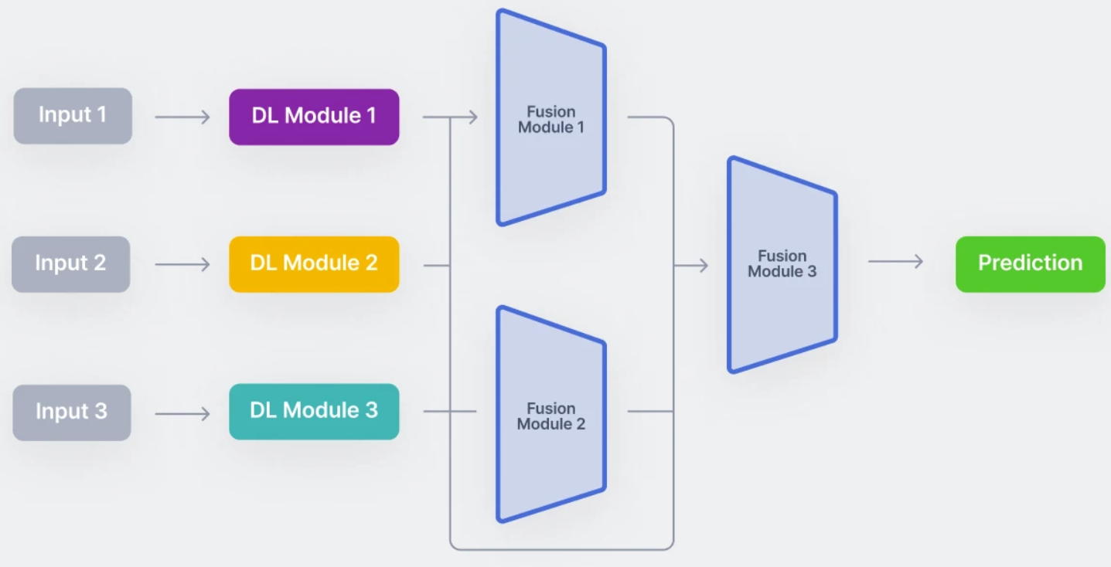
computer vision evolved from object-level research to scene-level tasks
Multi-modal scene understanding has gained attention

Slide 4
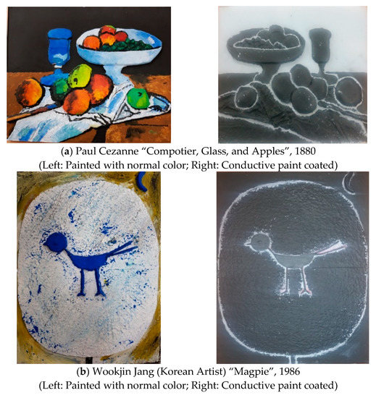
investigate complementarity of all three modalities (sketch, text, and photo)

Slide 5
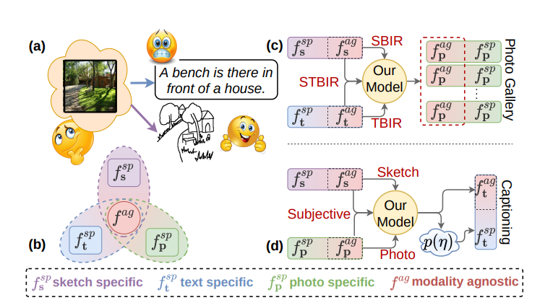
investigate complementarity of all three modalities (sketch, text, and photo)
modality-specific components
modality-agnostic carries shared abstract

Slide 6
Related Works
Sketch for Visual Understanding
Sketch-Based Image Retrieval
Multi-Modality in Computer Vision

Slide 7
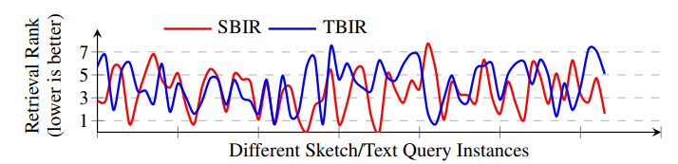
Pilot Study
Sketch vs. Text for Retrieval

Slide 8
Pilot Study
Sketch vs. Text for Retrieval
Subjectivity for Captioning
using sketches as a guiding signal for subjective captioning.
Better than traditional captioning methods

Slide 9

Methodology

Slide 10
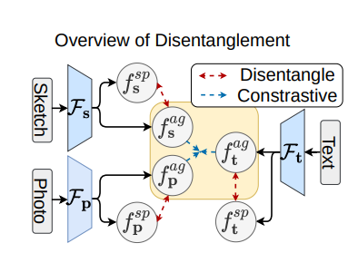
disentanglement of modality-agnostic and modality-specific components from sketch, text, and photo modalities.
the process of separating or extracting distinct features

Slide 11
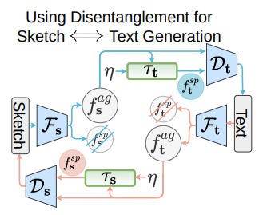
Utilization of the modality-agnostic sketch component across modalities.

Slide 12
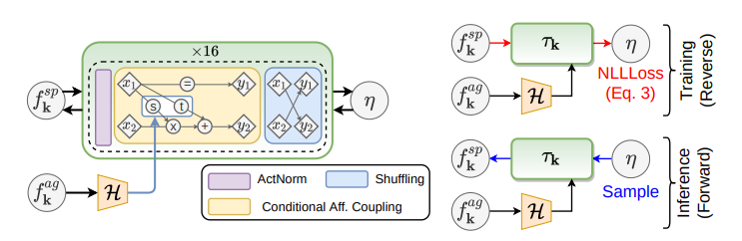
During training
During inference

Slide 13
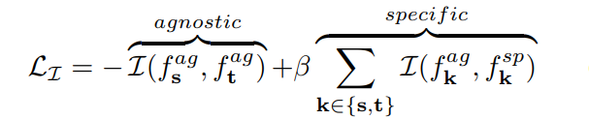
Optimization

Slide 14
Optimization
Extending to More Modalities
Based on models

Slide 15
Optimization
Extending to More Modalities

Slide 16
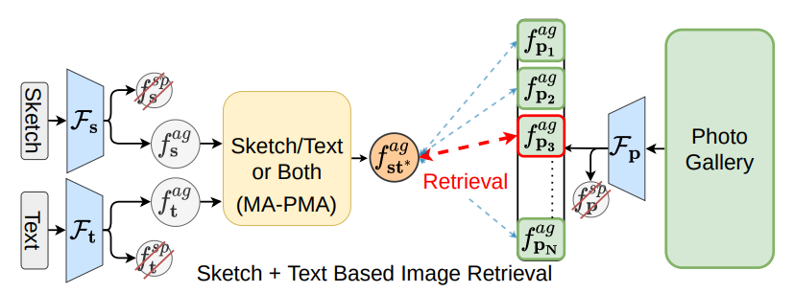
Result
Sketch + Text Based Image Retrieval

Slide 17
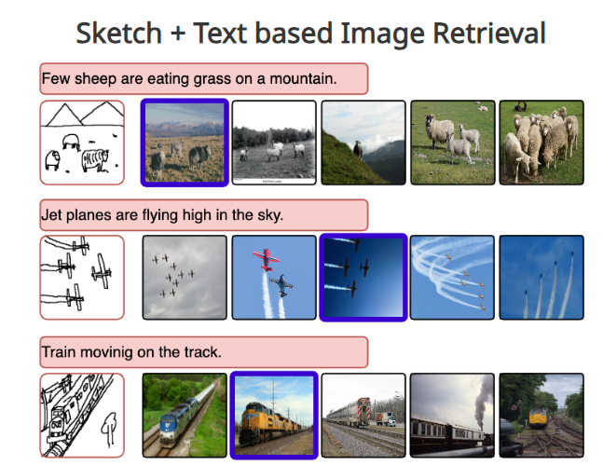
Result
Sketch + Text Based Image Retrieval

Slide 18
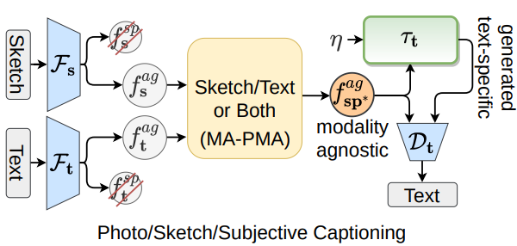
Result
Sketch + Text Based Image Retrieval
Photo/Sketch/Subjective Captioning

Slide 19
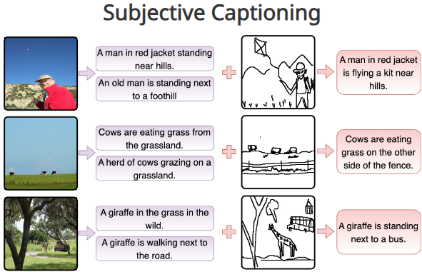
Result
Sketch + Text Based Image Retrieval
Photo/Sketch/Subjective Captioning

Slide 20

Ideas??!
Using robustness for data and model
Apply DRL using gflow- net

